Slide 1
WORLD ELECTRICITY ANALYSIS

Slide 2
AGENDA
Project Recap
The Analytics Team
Problem
Process
Dashboard
Insights

Slide 3
MEET OUR TEAM
Keshav Singh Rajput
ROBIN SINGH
Munazza BHOMBAL
SHRINIKET DANANE

Slide 4
Introduction
This is a analytical project where the data is related to the WORLD ELECTRICITY DISTRIBUTION. There are different insight we have concluded after analysis. The insights are basically related to the
RURAL and URBAN DISTRIBUTION,
ENERGY GENERATION SOURCE
and other importance insight have been made.

Slide 5
PRIMARY GOALS
WORLD ELECTRICITY ANALYSIS
Use Python to parse and convert the json data in a format so that the SQL can interpret it
Comparison of access to electricity post 2000s in different countries
Find one interesting insight present in the data (across all the tables)
Present a way to compare every country’s performance with respect to world average for every year. As in, if someone wants to check how is the accessibility of electricity in India in 2006 as compared to average access of the world to electricity
A chart to depict the increase in count of country with greater than 75% electricity access in rural areas across different year. For example, what was the count of countries having ≥75% rural electricity access in 2000 as compared to 2010.
Define a way/KPI to present the evolution of nuclear power presence grouped by REGION and IncomeGroup. How was the nuclear power generation in the region of Europe & Central Asia as compared to Sub-Saharan Africa. A chart to present the production of electricity across different sources (nuclear, oil, etc.) as a function of time
How was the nuclear power generation in the region of Europe & Central Asia as compared to Sub-Saharan Africa.

Slide 6
COMPARISON TO EXCESS OF ELECTRICITY POST 2000
The analytical data shows distribution of electricity w.r.t different countries.
Different countries shows different analytical distribution,
After analysis we made a conclusion that there are 64 such countries who has 100% distribution of electricity POST 2000
And there are 4 such countries who has 0% distribution of electricity POST 2000.

Slide 7
Excess of electricity in past 10 years
The data shows the Excess Of Electricity in past 10 years in Rural and Urban Region w.r.t Income class.
Here the Income class is changing variable.

Slide 8
Country's PERFORMANCE W.R.T WORLD AVERAGE FOR A PARTICULAR YEAR
The data shows the performance of a country on a particular year w.r.t World Average in a particular year.
Different year has different countries who perform is better than the World’s Average.

Slide 9
Count of countries with 75% population access to electricity YEARLY
The data shows Count of countries with population having >=75% access to electricity
Here 2020 has highest count of countries.

Slide 10
Evolution OF Nuclear power
The data shows evolution of nuclear power w.r.t Income class and Region.
Here as we can see that the High income and Europe & central Asia dominating in terms of evolution of nuclear power in long span of time.

Slide 11
Nuclear power generation comparison
The data shows the Nuclear power generation comparison of different countries over the years.
The data is divided by region also
As we can see in a long span of time Latin America and the Caribbean produce more nuclear power electricity than other regions.

Slide 12
PRODUCtion of electricity across different source
The data shows the performance of a country on a particular year w.r.t World Average in a particular year.
Different year has different countries who perform is better than the World’s Average.

Slide 13
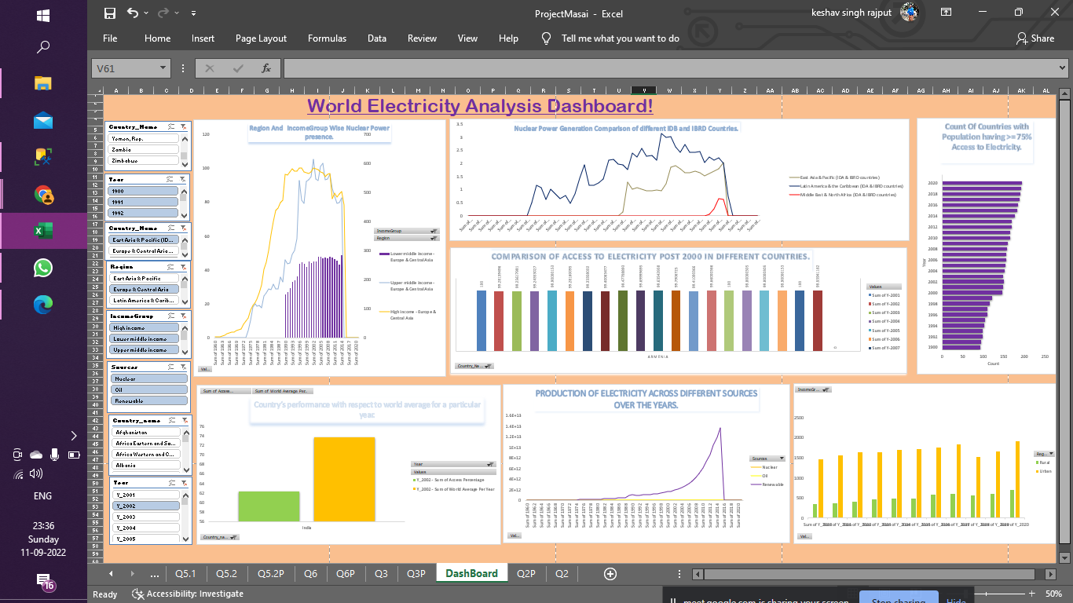
Dashboard
WORLD ELECTRICITY ANALYSIS

Slide 14
WORLD ELECTRICITY ANALYSIS
INSIGHTS
After analysis we made a conclusion that there are 64 such countries who has 100% distribution of electricity And there are 4 such countries who has 0% distribution of electricity POST 2000.
Here as we can see that the High income and Europe & central Asia dominating in terms of evolution of nuclear power in long span of time.
On comparison the nuclear power generation for different IDA and IBRD countries we found that Europe and Central Asia has highest % of Nuclear power generation in long span of time.
High Income class consume more electricity than the other 2 classes in Urban Region.

Slide 15
THANK YOU
MASAI TEAM

